Slide 1

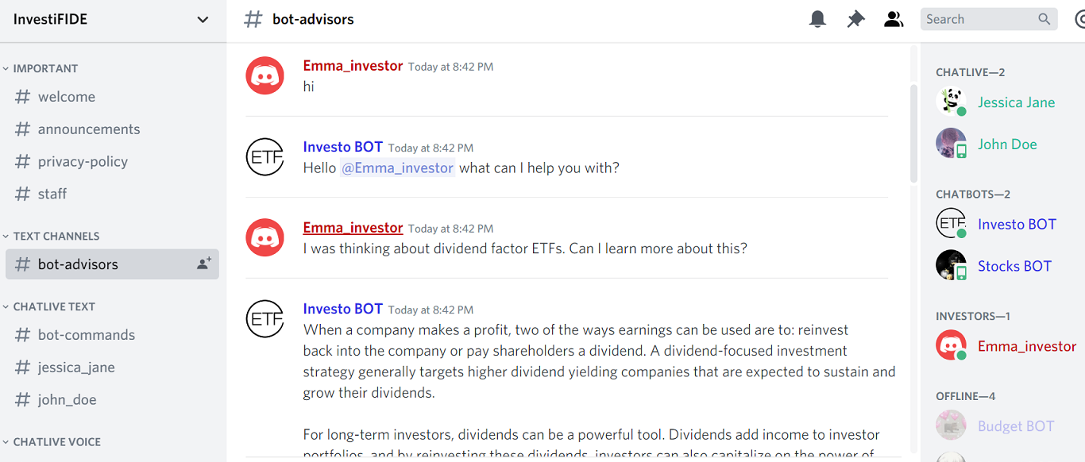

InvestiFIDE

Slide 2
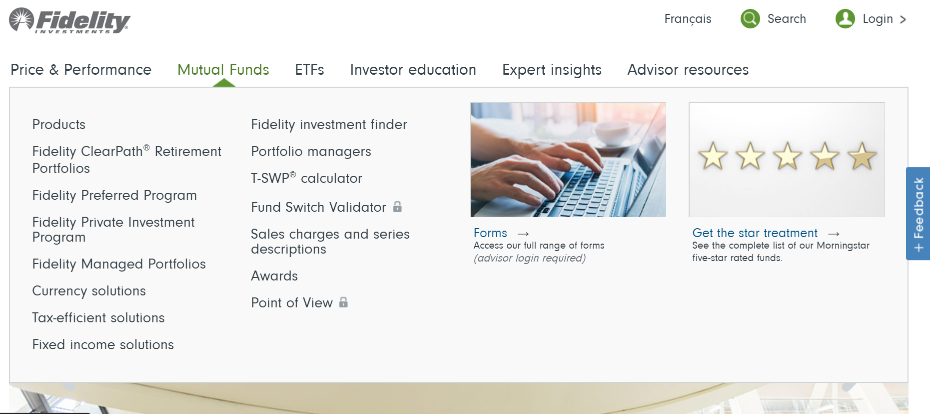

Problem statement
Hard to effectively find information
Too much information on fidelity.ca
Confusion

Slide 3

InvestiFIDE
Solution Statement
ConFIDE in the best.
Narrows down the potential investor’s search query
ChatBOT
ChatLIVE

Slide 4
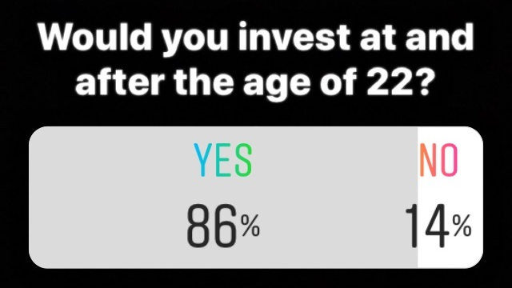
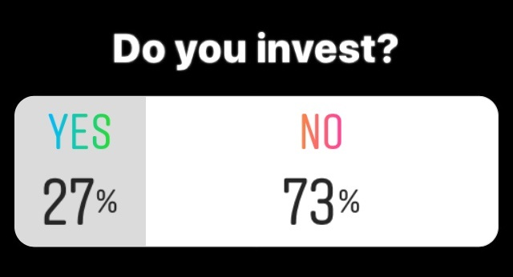
Collected Data
Conferred with over 50 potential investors
Time consuming
Good/Bad investment
Results of instagram polls and questionnaires

Slide 5
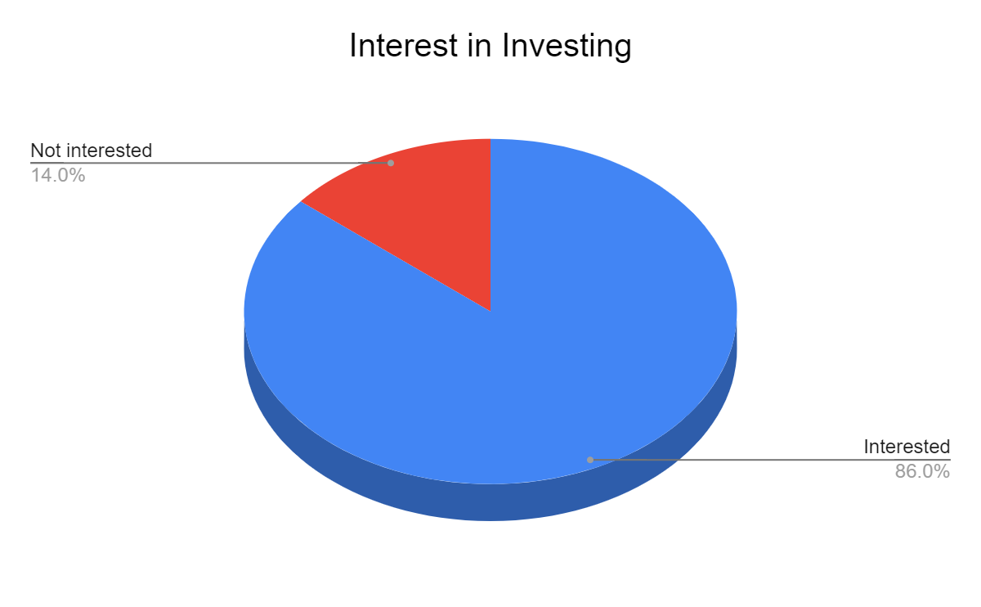
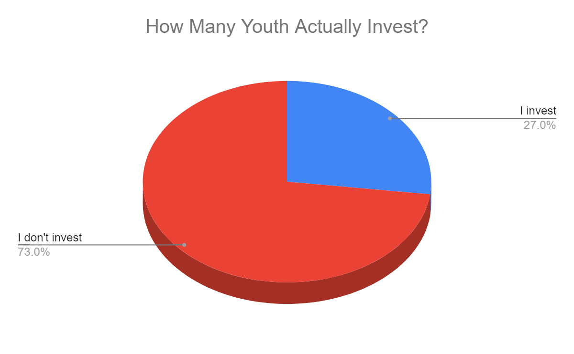
Data Analysis
86% of young adults want to invest
27% of them actually do invest

Slide 6
What makes us different?
More appealing to younger adults.
Eliminates transport time to advisors
Easy and quick access
Independent advisors can attract customers.

Slide 7
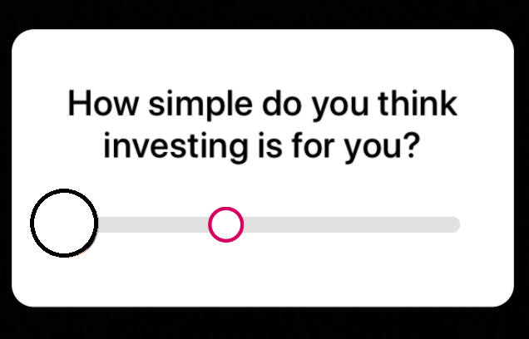
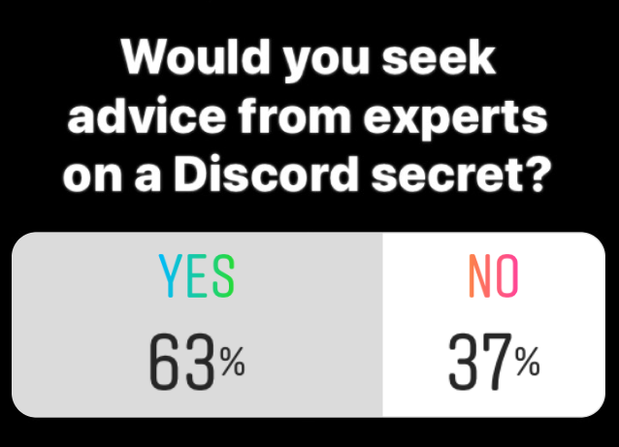
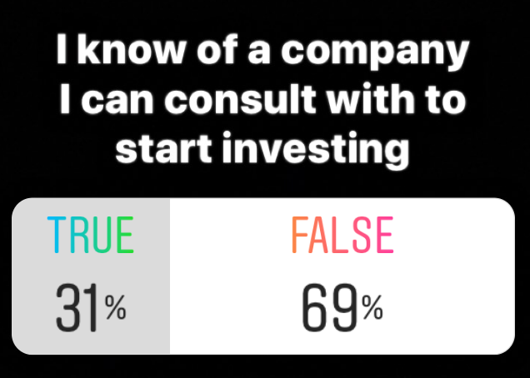
Traction
7M young adults of the ages of 22 to 36
Tech savvy, want to invest, enough funds to invest
Partner up with other university club and business servers
Develop server, ChatBOT and ChatLIVE features
rver

Slide 8
Timeline
OCT 2019 END
JUNE 2020
DEC 2020
IN 5 YEARS...
Bots that monitor and eliminate illegal practices
5000 active investors on the server
Over 20 partnerships with major university servers
The most recognizable investment company

Slide 9



Our Team
Priyal
Tanvi
Mansi
UI/UX Designer
Business Analyst
Programmer

Slide 10
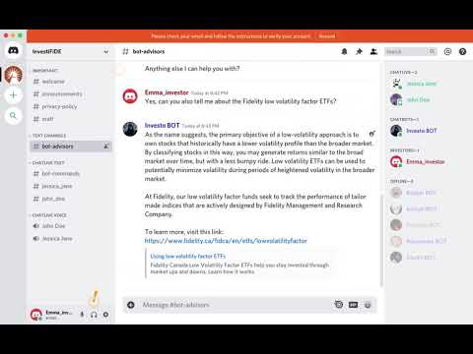
DEMONSTRATION

Slide 11
Questions?

